Slide 1
515 Jefferson St- Hoboken, NJ
By: Mikael Habib, Michael Huang, Chen Liu, Mohammed Kabir

Slide 2
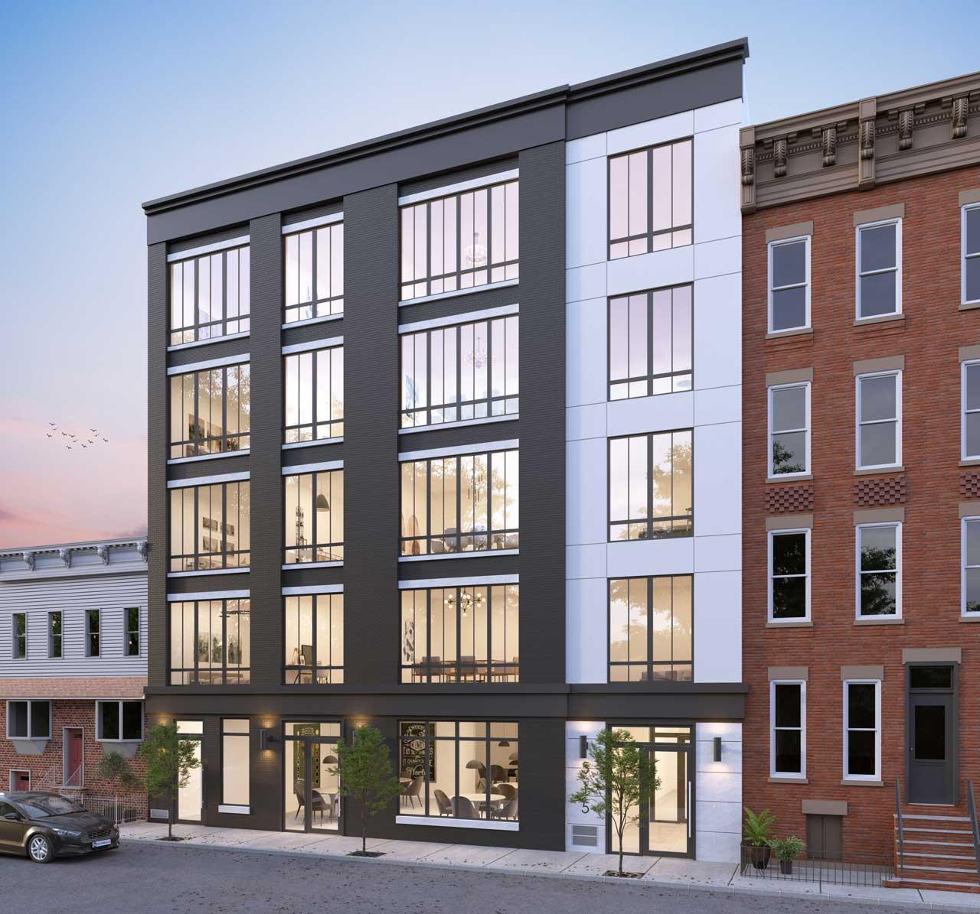
515 Jefferson St - Hoboken, NJ
Total Project Cost: $7.9m
Equity Required: $2.3m
4 Floors Residential, 1 Floor Commercial
15,000 Gross Sq. Ft.
~10,194 net Residential Sq. Ft.
~1,968 net Commercial
~2,838 net Saleable
Forecasted Total ROI: 52%

Slide 3
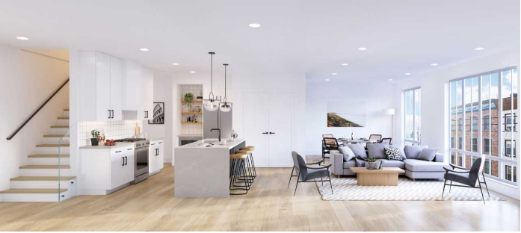
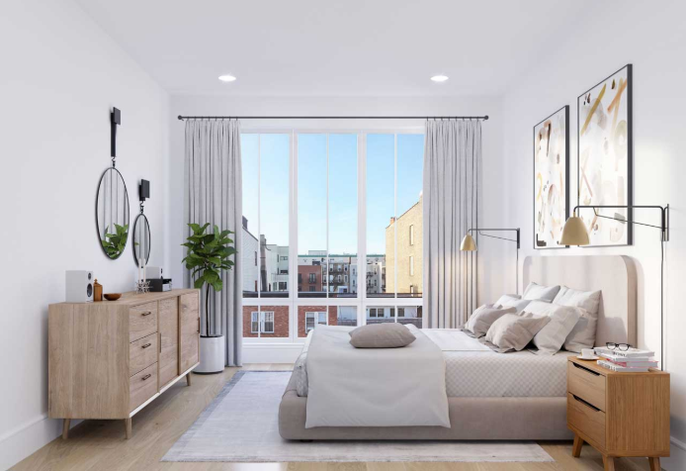
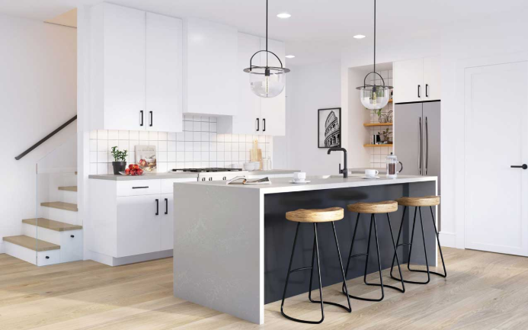
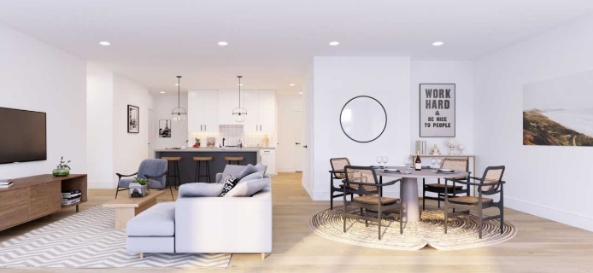
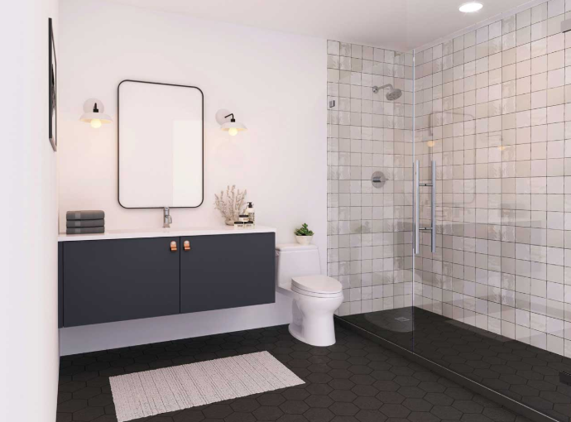
Upscaled Condominiums

Slide 4
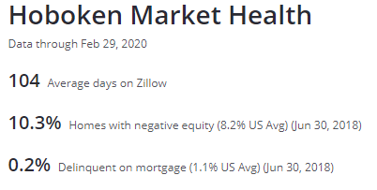
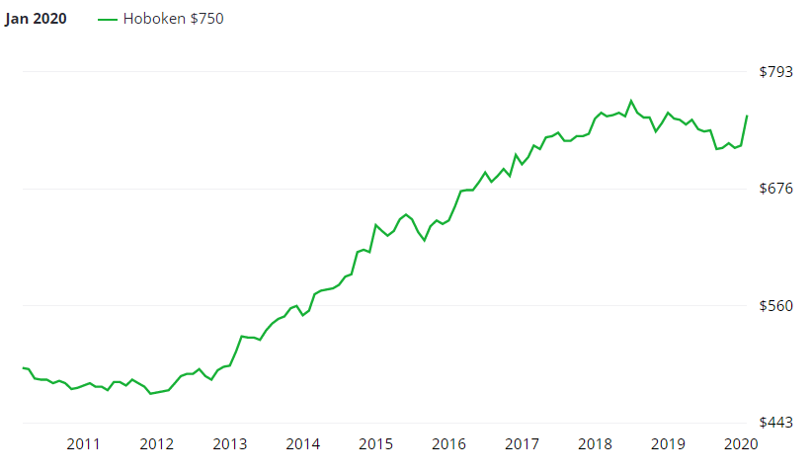
Hoboken
Hoboken’s Mortgage Delinquency rate is 80% lower than Average in US; at 0.2%
Less risk involved as there is a lesser chance for defaulting on Rent
Hoboken’s real estate has been in an uptrend for the past decade and this is projected to continue.
Inflation as a result of Federal Reserve’s Unlimited Quantitative Easing will cause real estate to appreciate in value over the next decade, and mortgage interests rates to go lower.

Slide 5
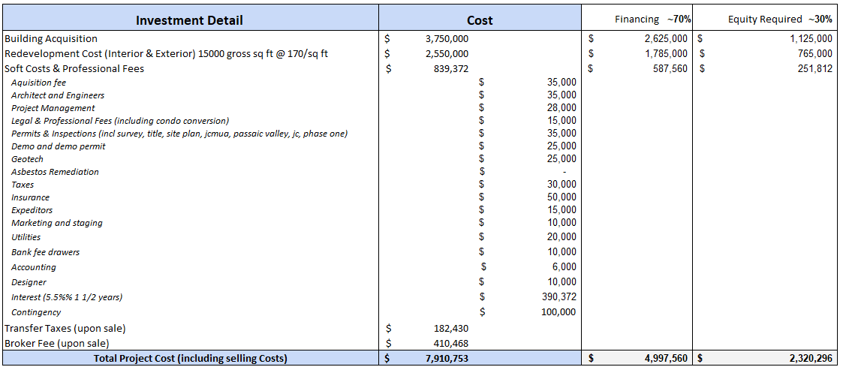
Project Costs

Slide 6
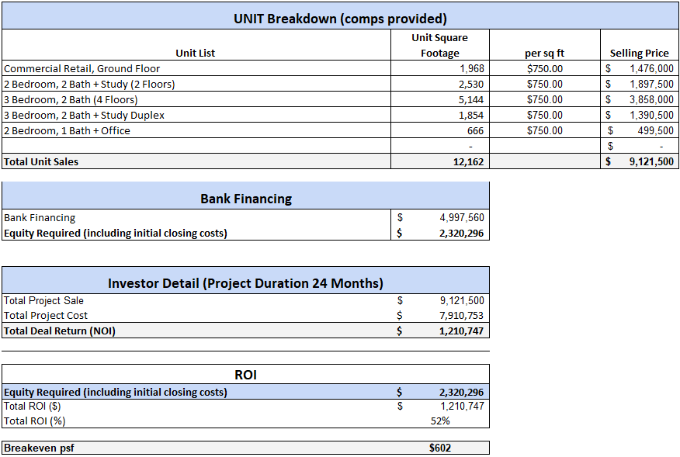
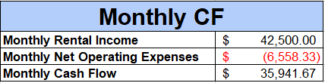
Financial Overview
Sale Price : 9.2m @$750/sqft.
Cash On Cash Return : 52%
Rent Roll : $42,500 Monthly Cash Flow : $35,941

Slide 7
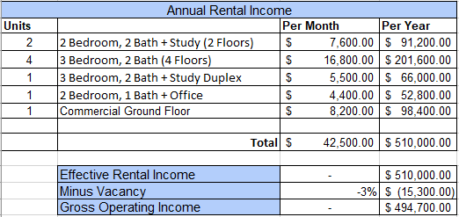
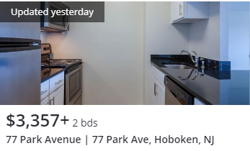
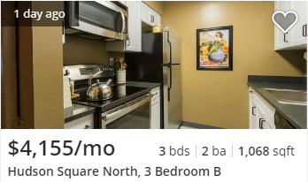
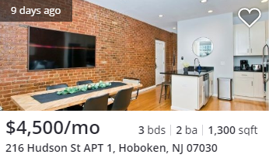
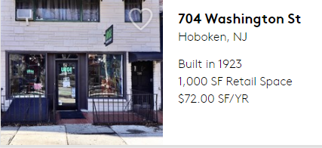
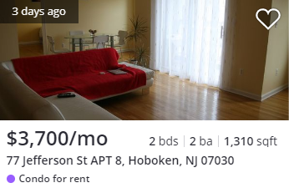
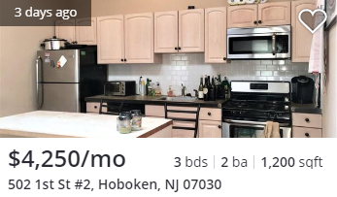
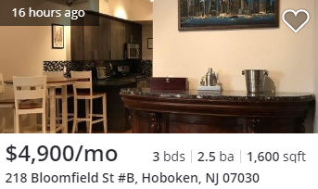
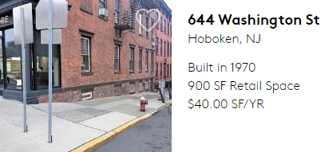
Rental Scenario with Comps
$3,800 Monthly
$4,200 Monthly
$5,500 Monthly
$4,400 Monthly
$8,200 Monthly
[2 Units] 2 Beds + 2 Baths + Study
[4 Units] 3 Beds + 2 Baths
[1 Unit] 3 Beds + 2 Baths + Duplex
[1 Unit] 2 Beds + 1 Bath + Office
[1 Unit] Commercial Ground Floor
2 Beds + 2 Bath
3 Beds + 2 Bath
2 Beds + 2 Bath + Extra Space
Commercial Lease

Slide 8
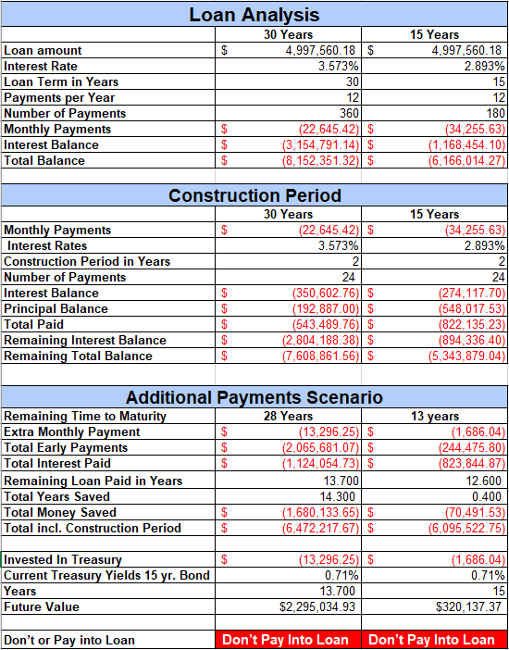
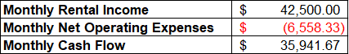
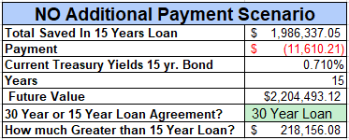
30 Yr. vs 15 Yr. Loan Agreement
Cash Flow is higher than Loan Payments
Net Profit : $13,296 per month accounting for NOE
Reinvesting the net profits back into loan payments will yield less return than same investment in 15 Year Treasury Bond at 0.71% current yield.
30 Year loan will still outpace 15 Year loan if difference in payments are invested in same 15 Year Treasury Bond with 0.71% current yield.
30 Year loan is the better deal unless difference in payments don’t get invested.
Both Scenarios for Reinvesting surplus in cash flow back into loan payments are not favorable

Slide 9
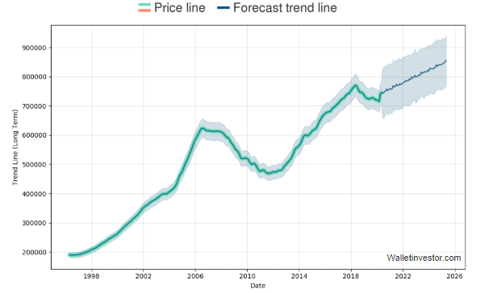
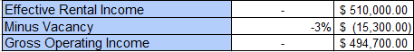
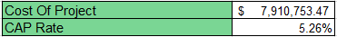
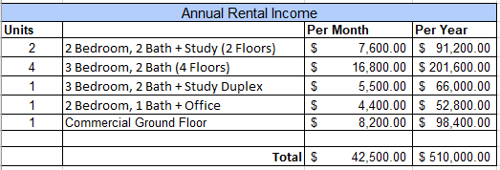
Sell Property or Rent?
Real Estate Markets in Hoboken area are still projected to continue rising.
Federal Unlimited Quantitative easing, will cause inflation of the US Dollar.
Real Estate Values will increase along with inflation.
Selling the property will be only a 52% gain rather than $490,000 collected as rent annually vacancy included.
This year may be one of the best times to invest for the long-term, by securing sources of income such as this building.
Cap rate is low at 5.26% meaning it’s low risk.
Overall the better choice is to keep this building as a rental property.

Slide 10
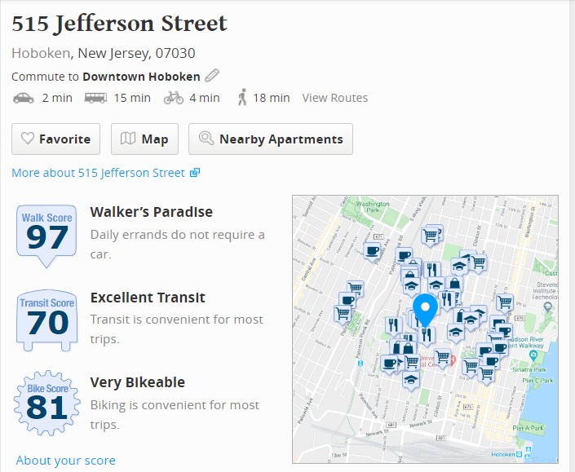
Walkscore
Similar to the city, everyday tasks can be done without need of a car.
Public transportation ranges from
PATH train, NJ Transit buses or trains, and the NY Waterway ferry
Easy Transit
-126 Bus (0.2 m)
- Hudson Bergen Light Rail (0.4 m)
- PATH Train (0.7 m)

Slide 11
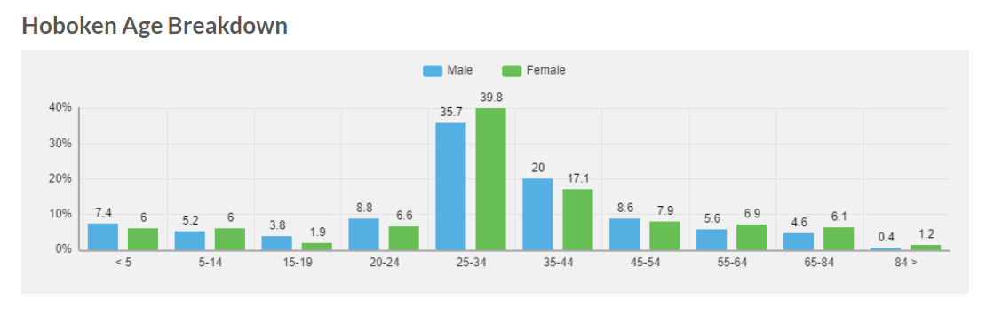
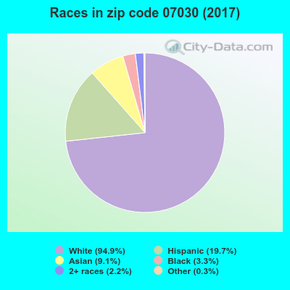
Demographics
The median age in Hoboken is 20% lower than most of New Jersey and the top three race groups in the area are Caucasian, Hispanic, and Asian.

Slide 12
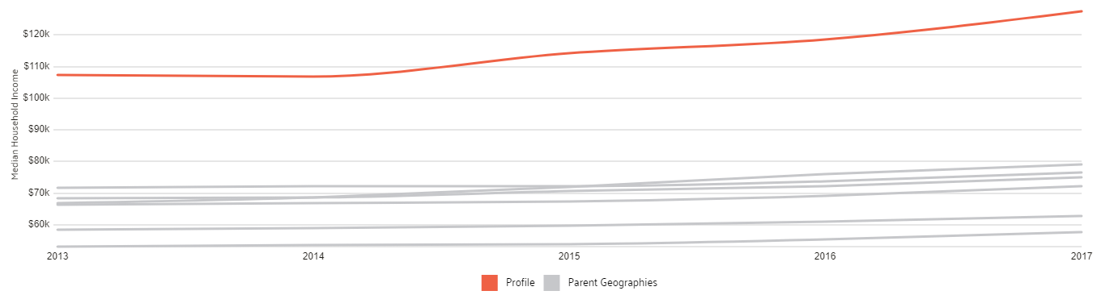
Median Household Income in Hoboken
Households in Hoboken, NJ have a median annual income of $127,523 which is more than the median annual income of $61,937 across the entire United States. This means that issues regarding tenants not paying rent will have a less likely chance of occuring.

Slide 13
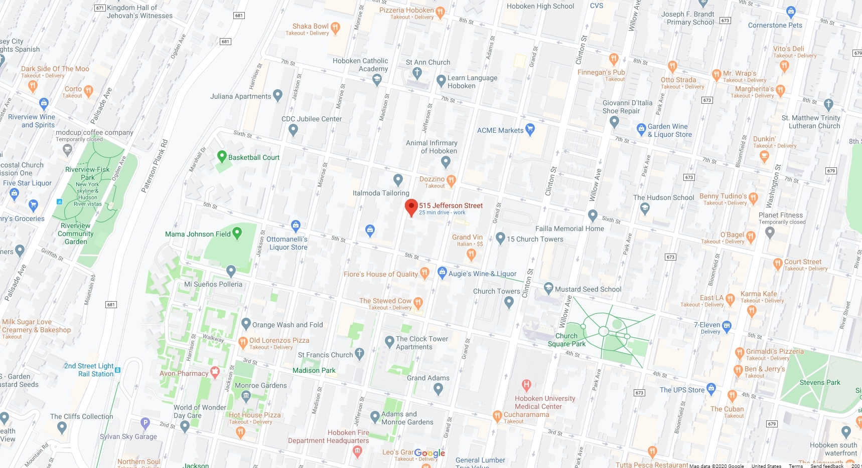
A Bird’s Eye View of the Area

Slide 14
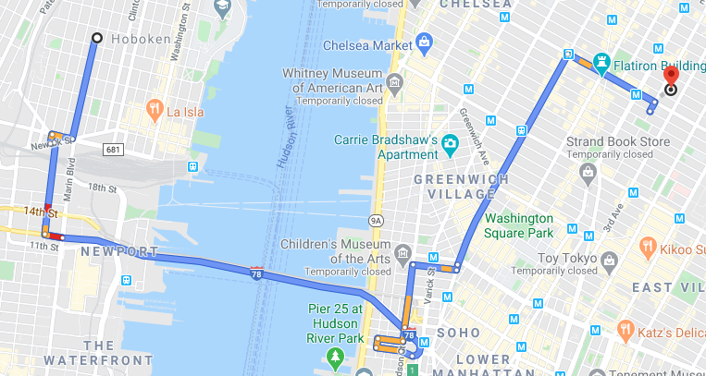
Only 23 mins away from Baruch via driving!

Slide 15
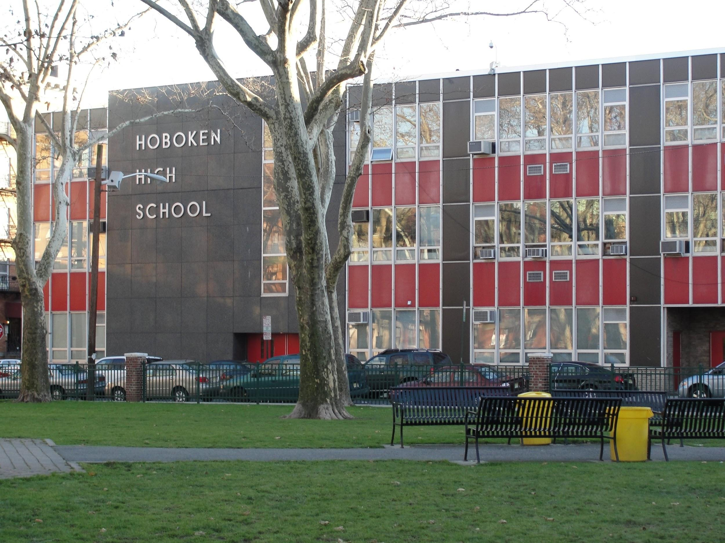
Education In the Area
Public Schools (All within 0.35 miles):
-Salvatore R. Calabro, No. 4 Elementary School (K-6)
- Hoboken Middle School (7-8)
- Hoboken High School (9-12)
Colleges:
- Stevens Institute of Technology
- Hudson County Community College

Slide 16
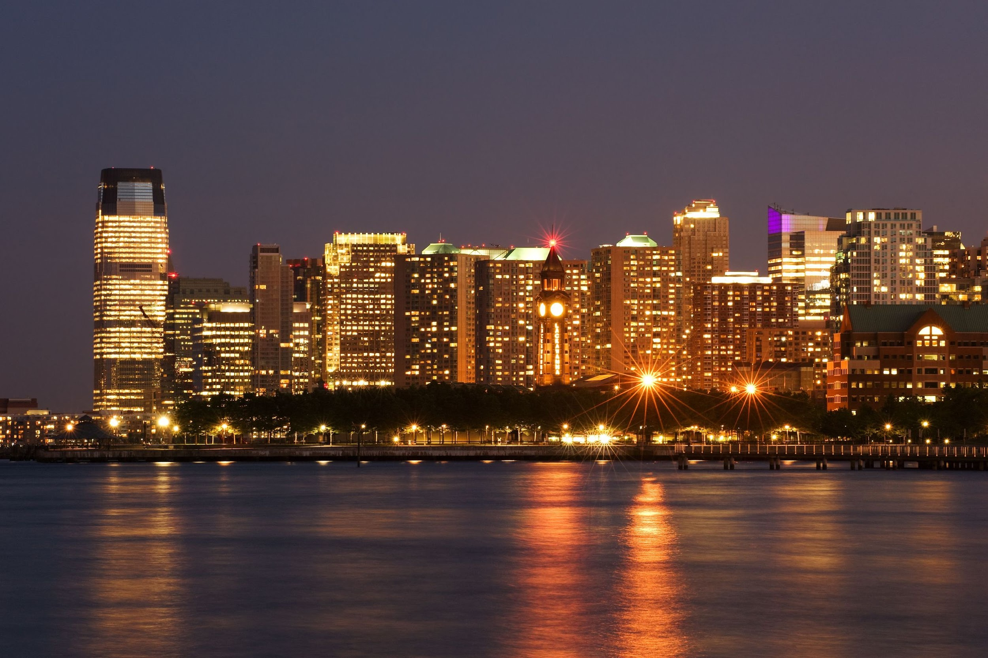
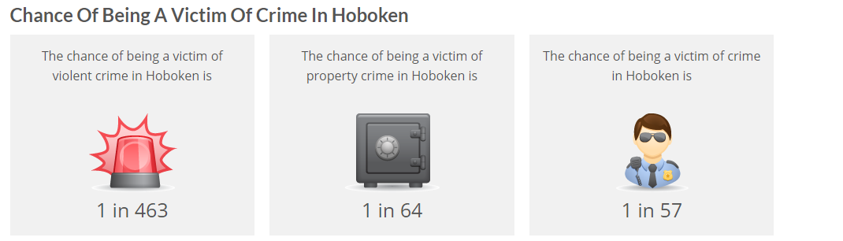
Neighborhood Safety
-Hoboken crime rates are 31% lower than the national average
-Violent crimes in Hoboken are 43% lower than the national average
- In Hoboken you have a 1 in 57 chance of becoming a victim of crime

Slide 17
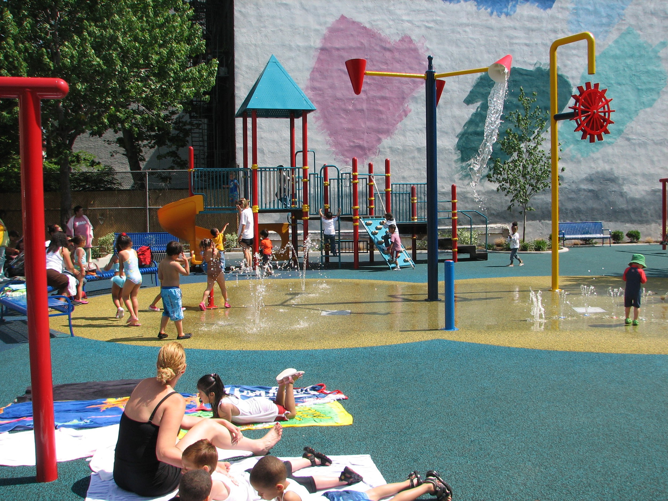
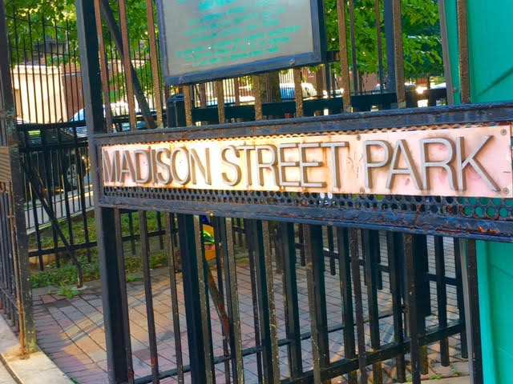
Nearby Parks
-Madison Park (5 minute walk)
-Church Square Park Dog Run (6 minute walk)
-Jackson Street Park( 9 minute walk)

Slide 18
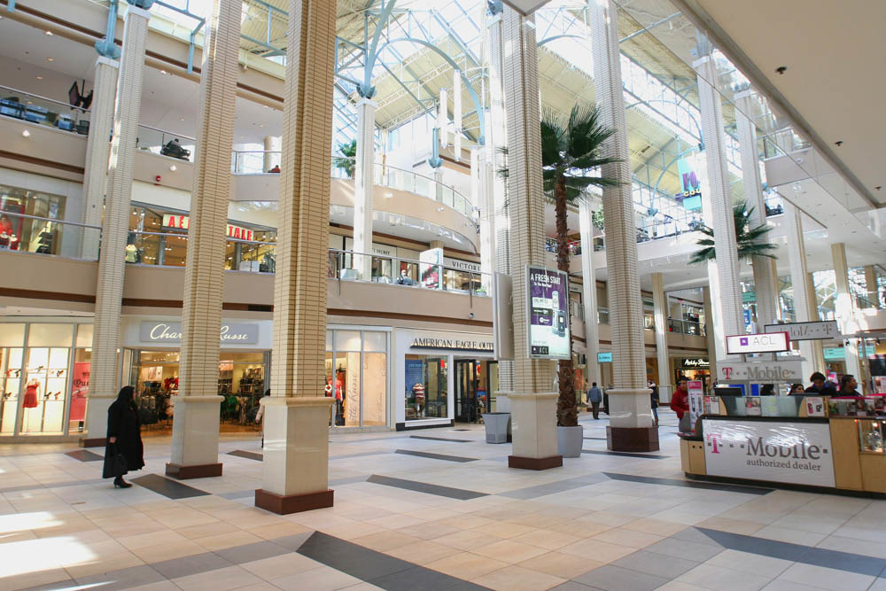
Shopping Centers
Newport Center
Shops at Lincoln Harbor
Newport Centre is the premier shopping destination offers 3 levels of shopping in the heart of the Newport Hudson Waterfront Community in Jersey City.
The center features more than 130 specialty shops ranging from women’s apparel, to health and beauty to sporting goods. Topped by an 11 screen cinema and a 1,000 seat Dining Pavilion

Slide 19




Facilities for use
Stores:
Models Sporting Goods (8 minutes away)
Walgreens (5 minutes away)
Target (3 minutes away)
ACME Markets (2 minutes away)
Best Buy (7 minutes away)
Facilities:
Intrepid Gym (4 minutes away)
Planet Fitness (5 minutes away)
AMC Newport Centre 11 (9 minutes away)

Slide 20
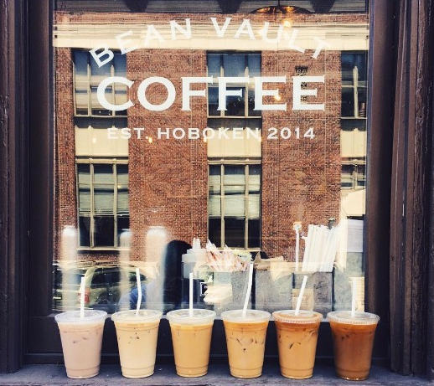
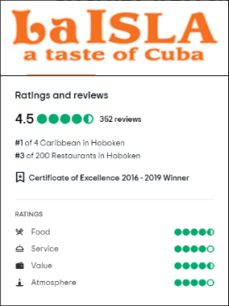

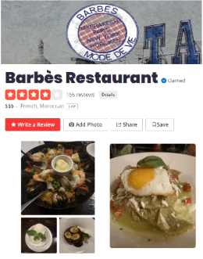
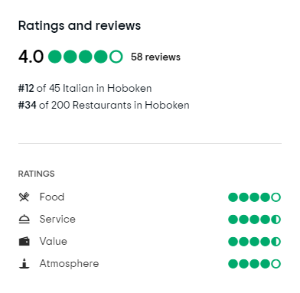
Restaurants
Restaurants
Hoboken area includes many different cultural cuisines all around.
Location of the building is within walking distance of many restaurants.
Average Scoring of restaurants in the area is around 4 stars, ranging from 3.5 to 4.5

Slide 21
Thank you for your time!

